Slide 1
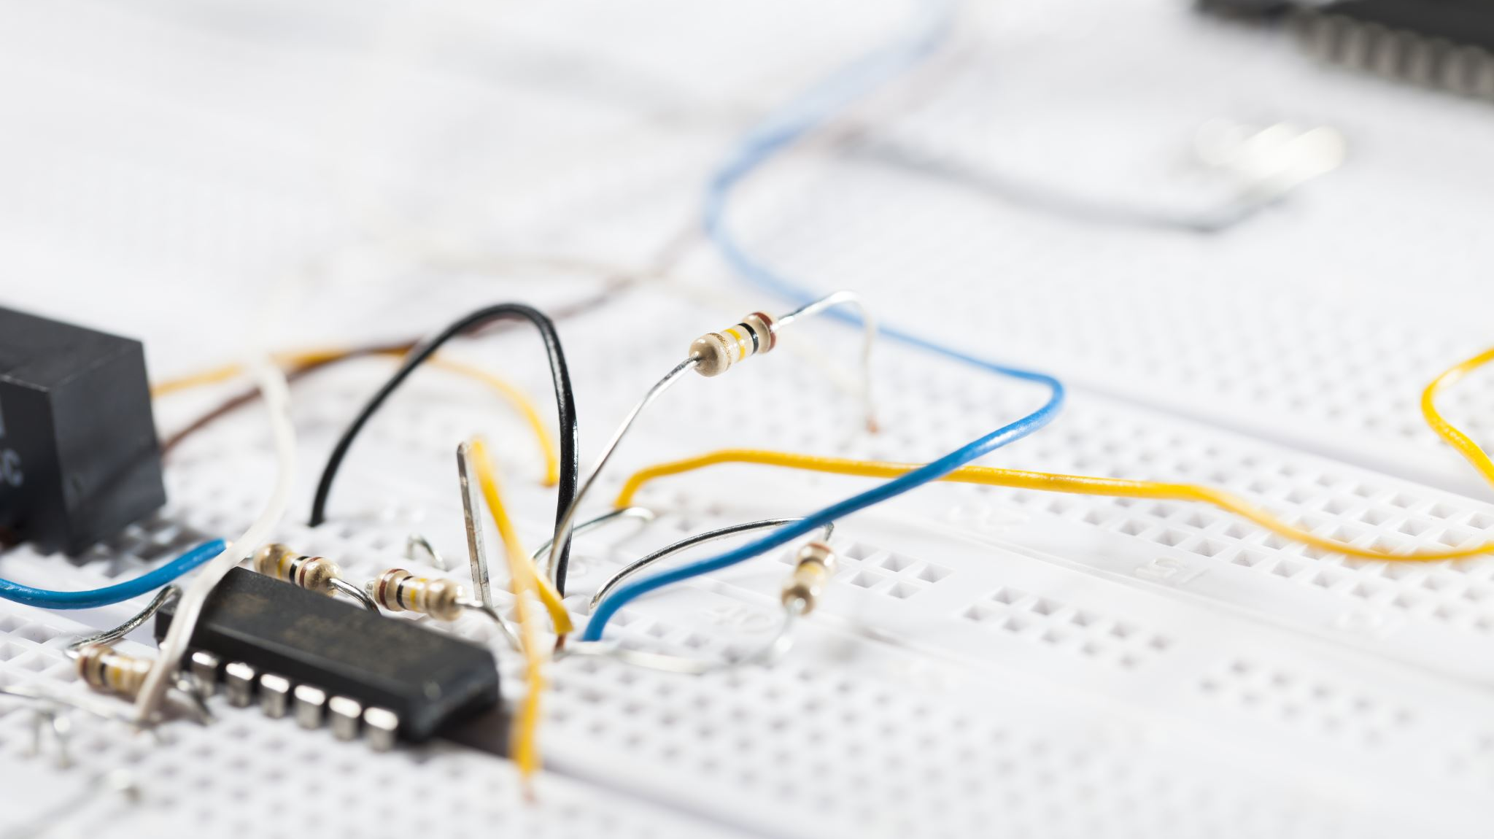
EN2091 Analog Project
Team Supertronics
230045X
230140J
230477X
230730T
Anthony C.S.B.
Dharmakeerthi P.K.G.C.L.
Perera H.A.J.I.
Wijethilaka J.S.

Slide 2
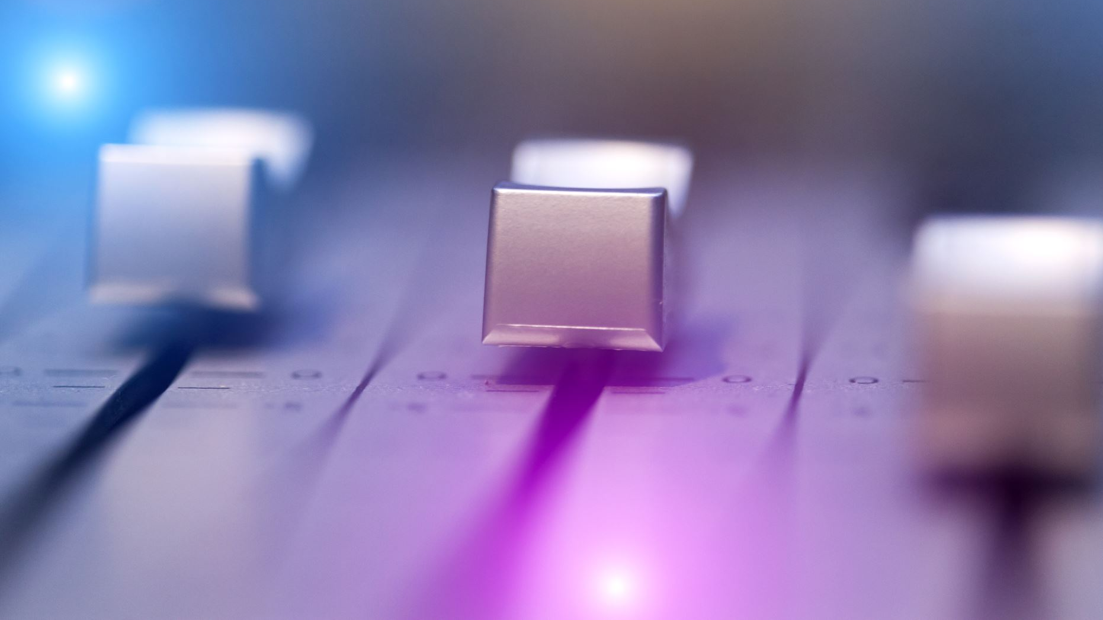
Analog Audio Effect Processor

Slide 3
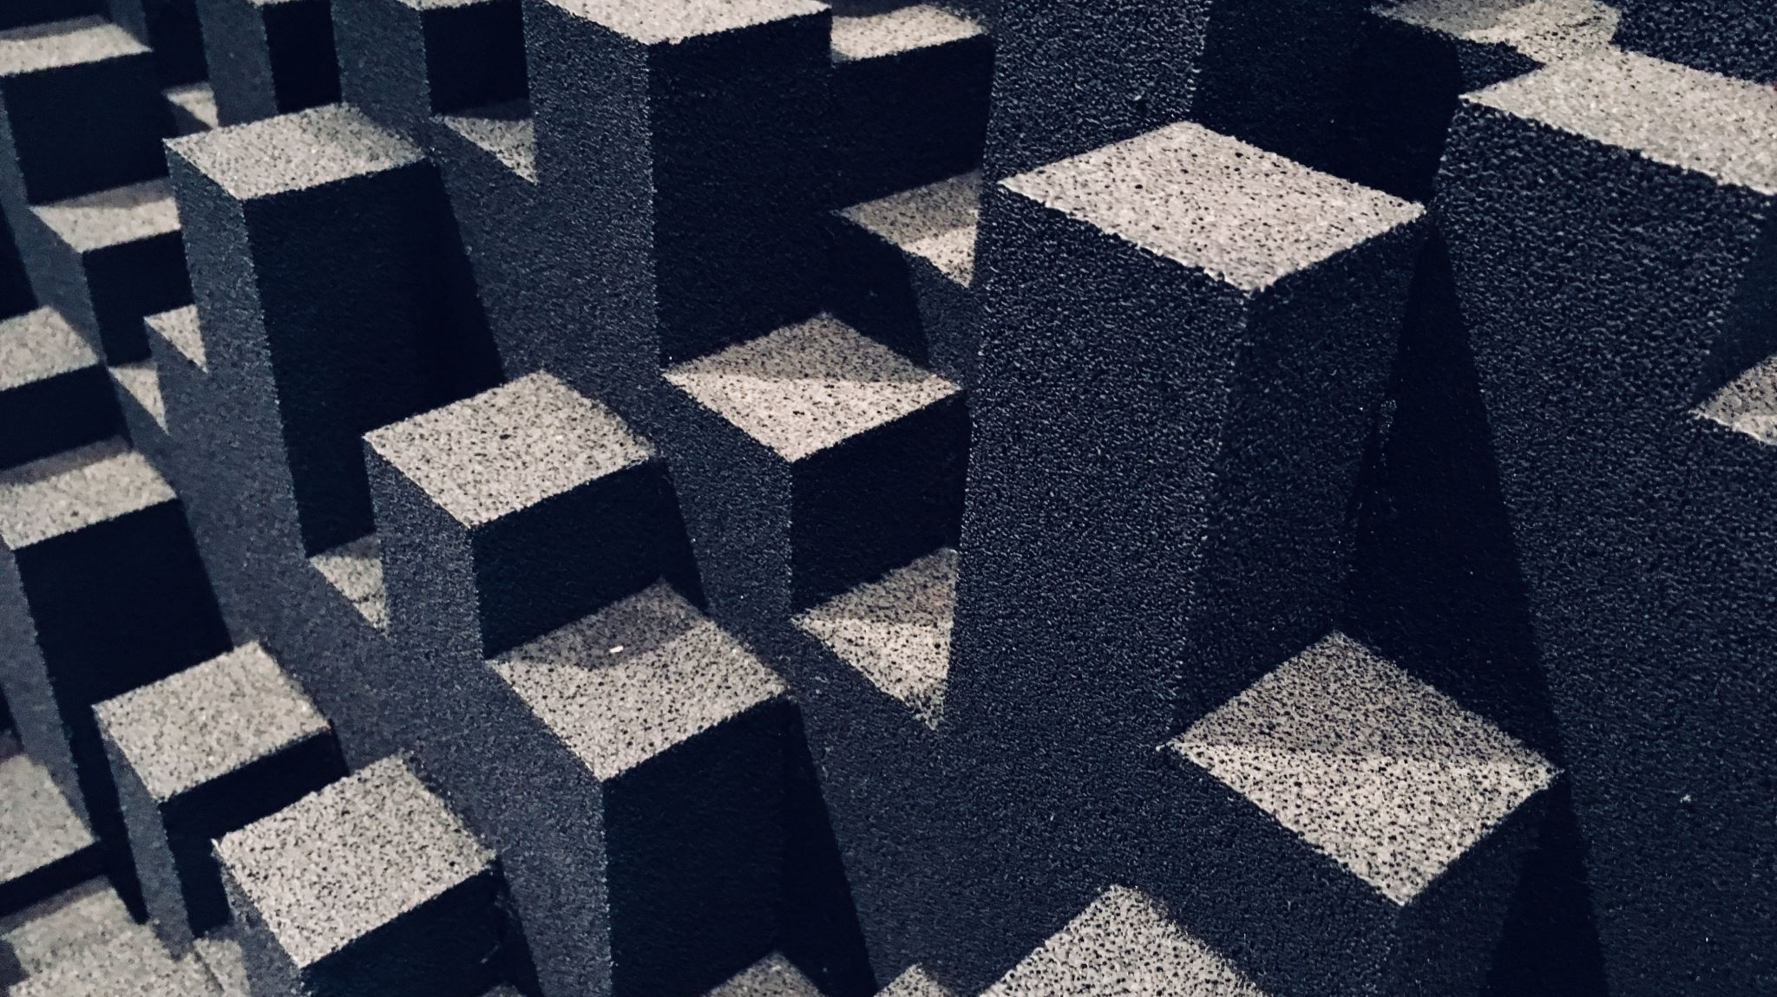
Block Diagram
Input Buffer
Equalizer
Tremolo
Overdrive
Phaser
Output Buffer
Regulated 12V Power Supply

Slide 4
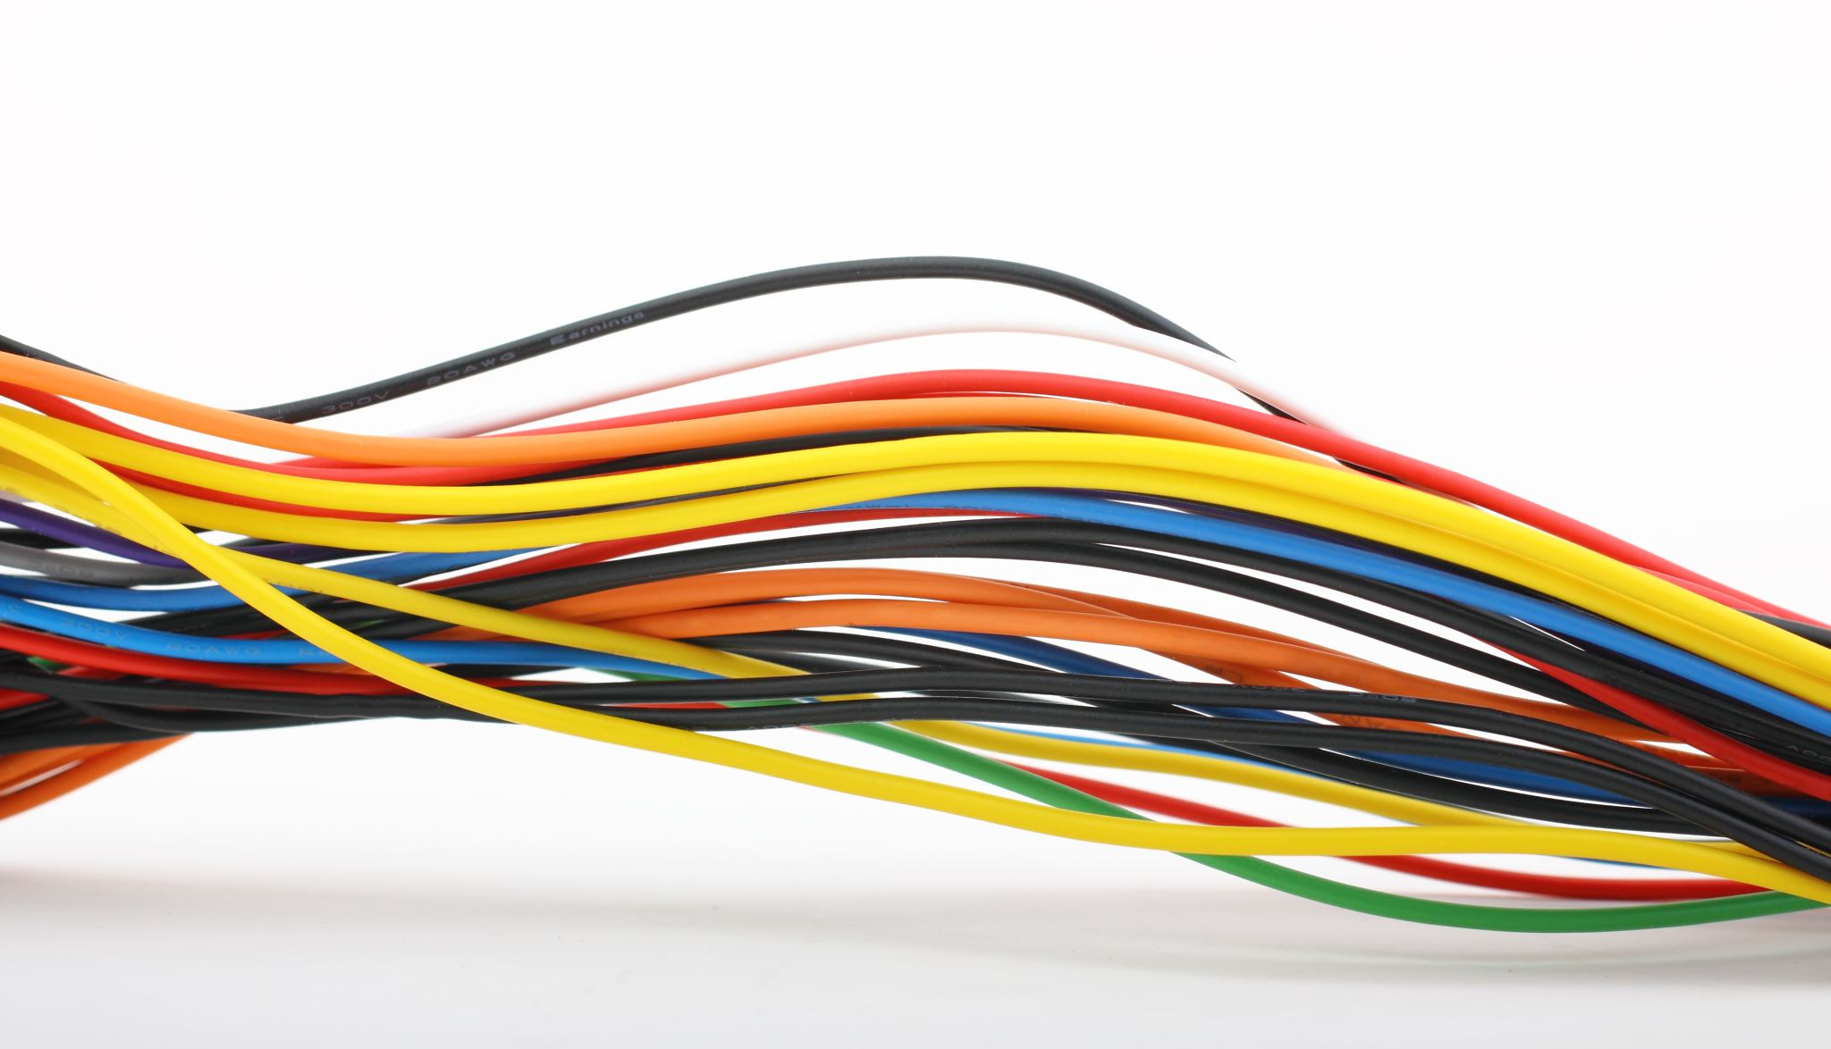
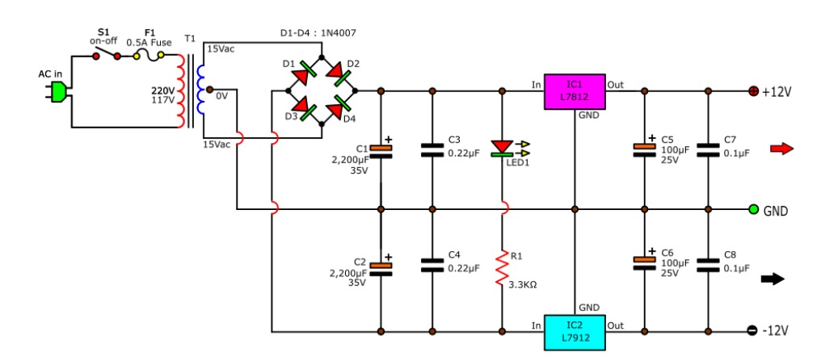
Power Supply

Slide 5
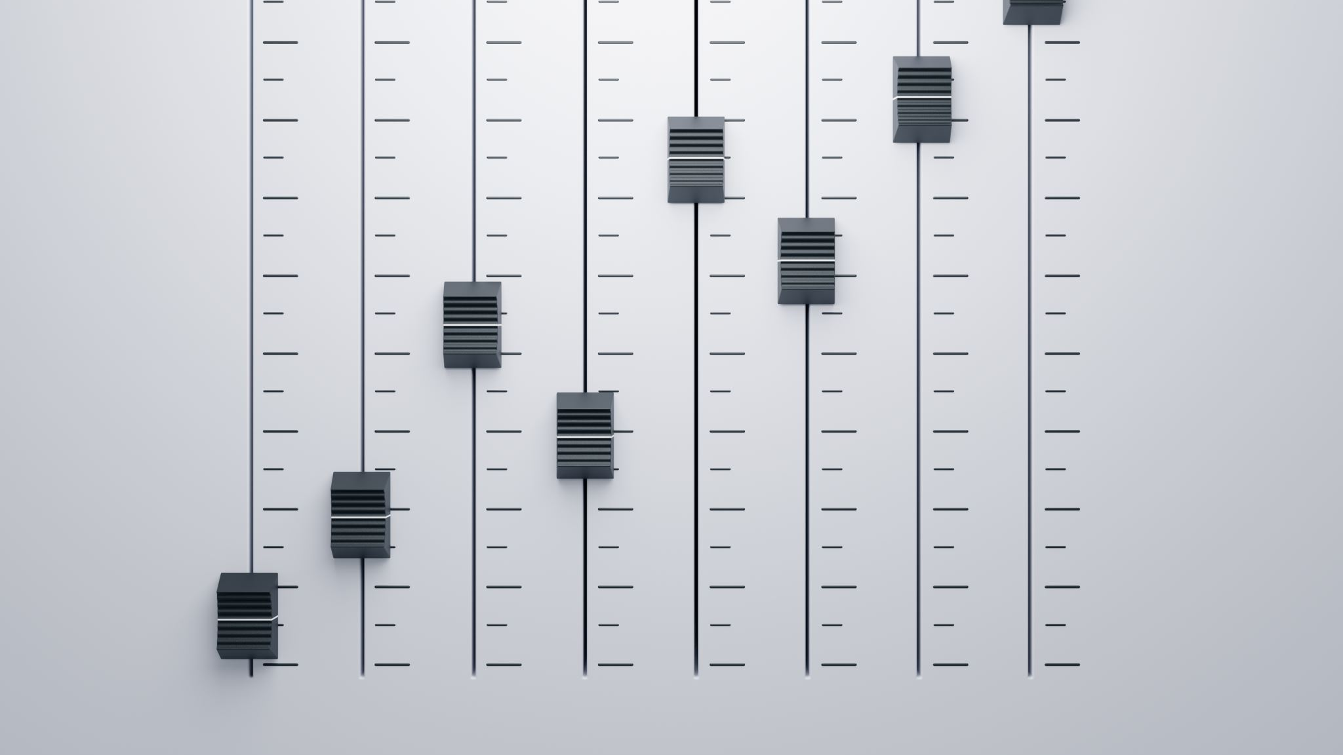
3-Band Audio Equalizer

Slide 6
3-Band Audio Equalizer
Introduction
3-band equalizer is an audio processing tool used to adjust the amplitude of different frequency bands in a sound signal.
Commonly used in audio systems, music production, and live sound to shape the tonal quality of audio.
Functionality
Allows boosting or cutting each frequency band independently and helps in improving clarity, warmth, and overall balance of audio.

Slide 7
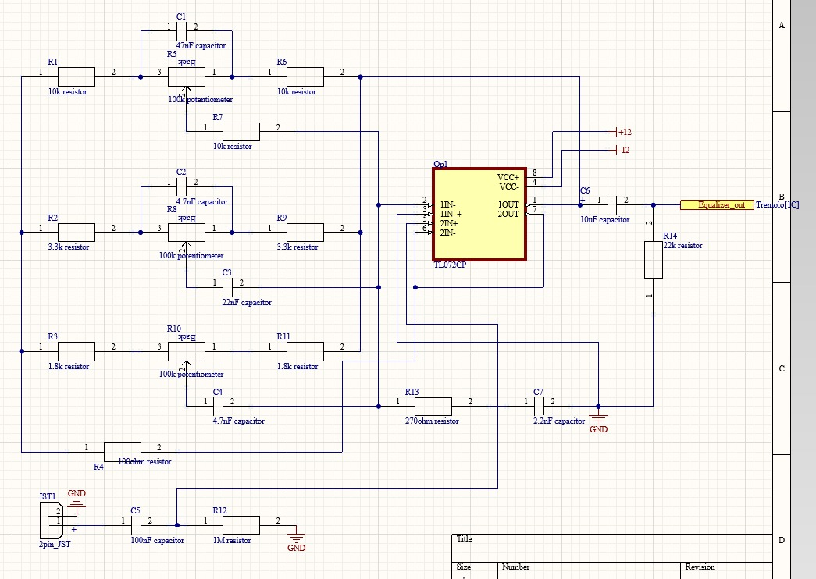
PCB Schematic (Audio Eq)

Slide 8

Overdrive Module

Slide 9
Overdrive Module
Introduction
An Overdrive module is an audio effects unit that intentionally distorts the audio signal to produce a warm, saturated sound.
Commonly used in electric guitars, synthesizers, and audio processing to add harmonic richness and character.
Functionality
Boosts the signal and introduces harmonic distortion, making the sound more driven.
Includes controls for Gain ( amount of distortion) and Volume (output signal strength ).

Slide 10
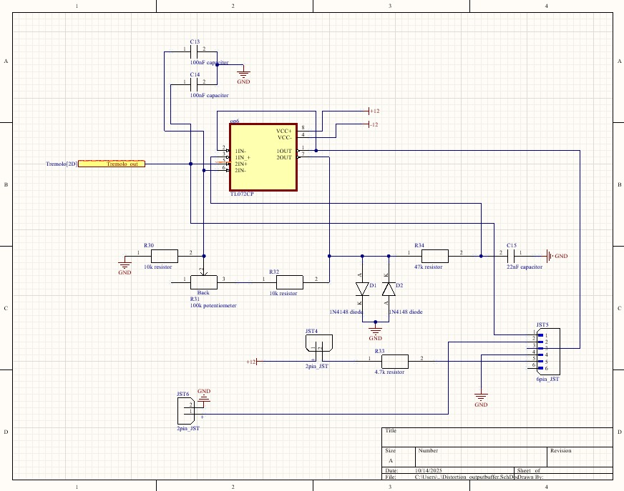
PCB Schematic (Overdrive Module)

Slide 11
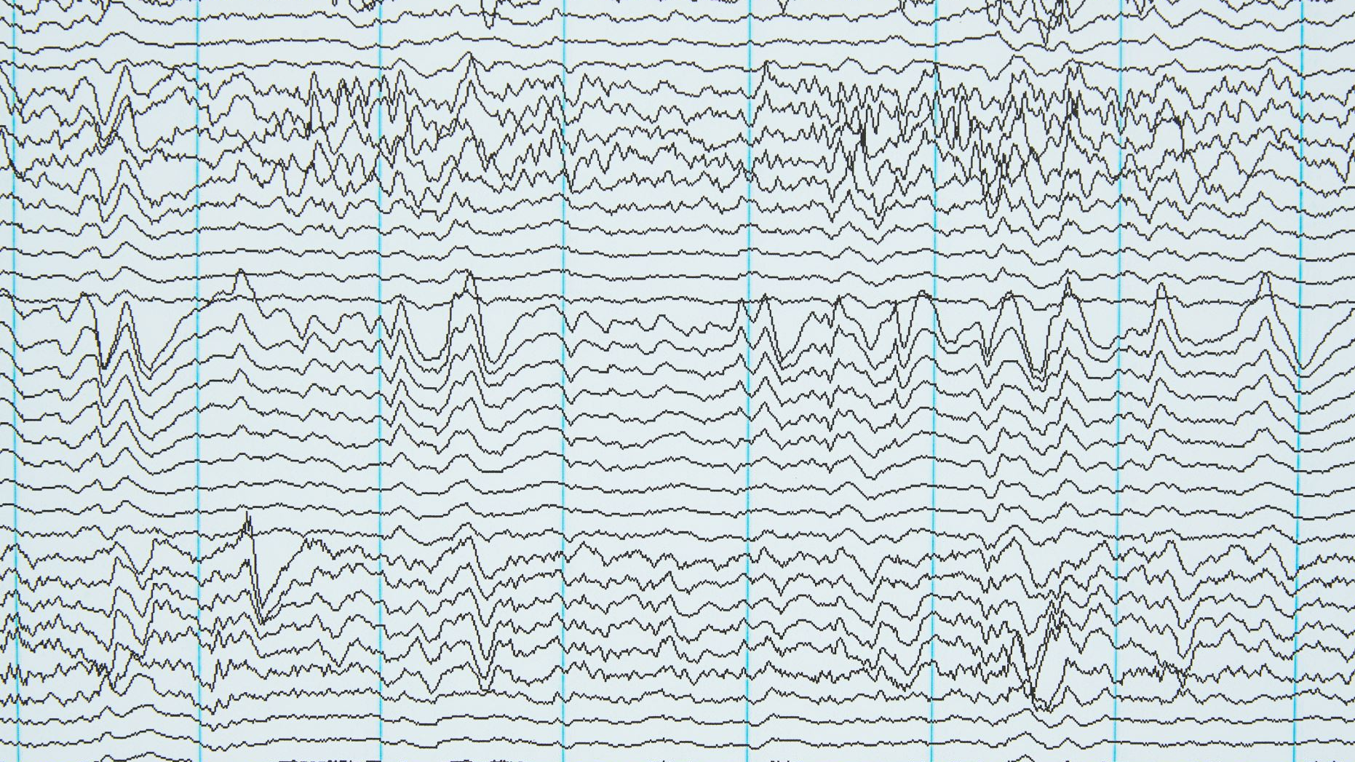
Tremolo Module

Slide 12
Tremolo Module
Introduction
A Tremolo module is an audio effect that modulates the amplitude (volume) of an audio signal periodically.
Functionality
Modulates the amplitude of the input signal.
Includes controls for Rate (speed of modulation) and Depth (intensity of the effect)

Slide 13
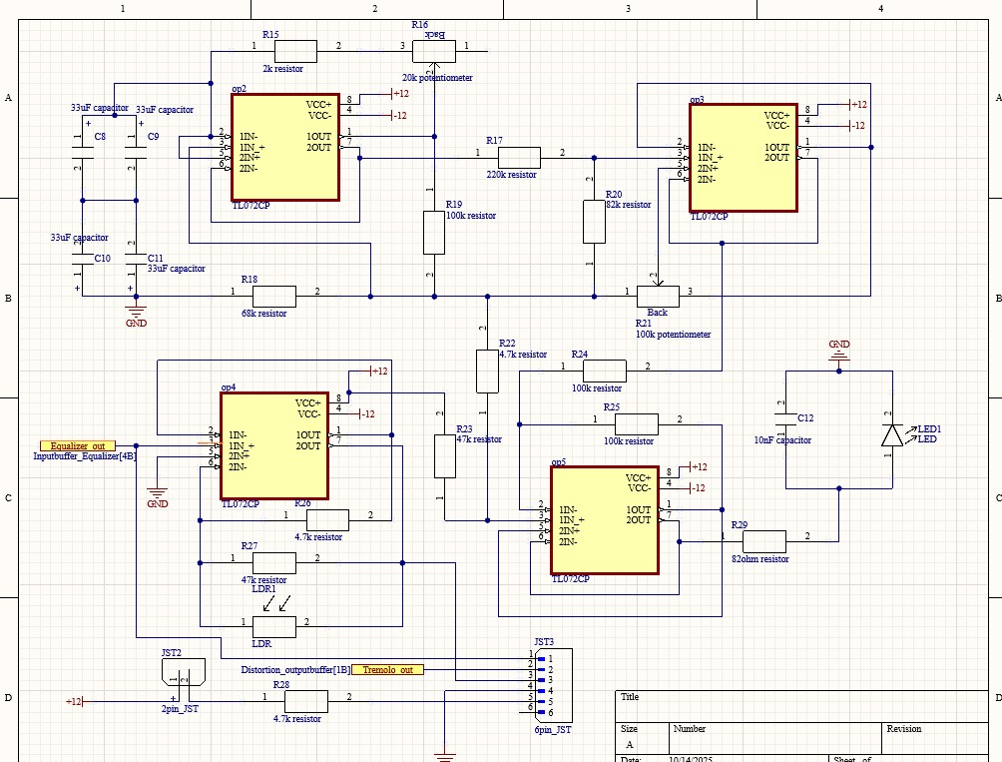
PCB Schematic (Tremolo Module)

Slide 14
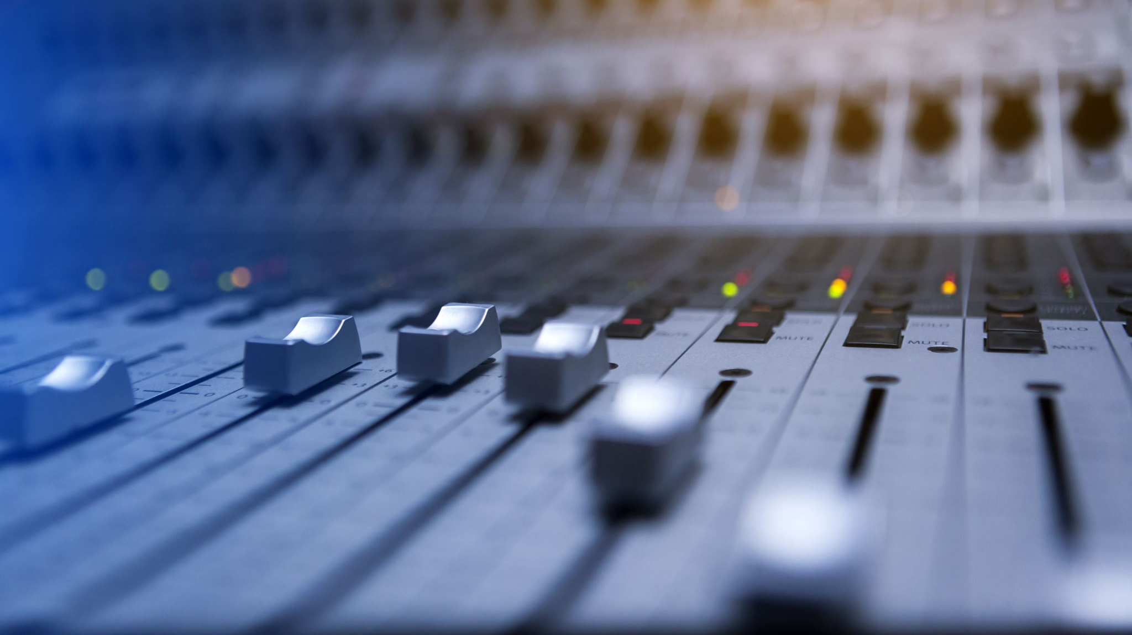
Phaser Module

Slide 15
Phaser Module
Introduction
A Phaser module is an audio effect that creates sweeping, swirling sounds by splitting the audio signal and shifting the phase of one part before recombining.
Functionality
Splits the input signal into two paths and shifts the phase of one path.
Recombines the signals, causing constructive and destructive interference, producing peaks and troughs in the frequency spectrum.
Includes controls such as Rate (speed of sweep) and Depth (intensity of effect)

Slide 16
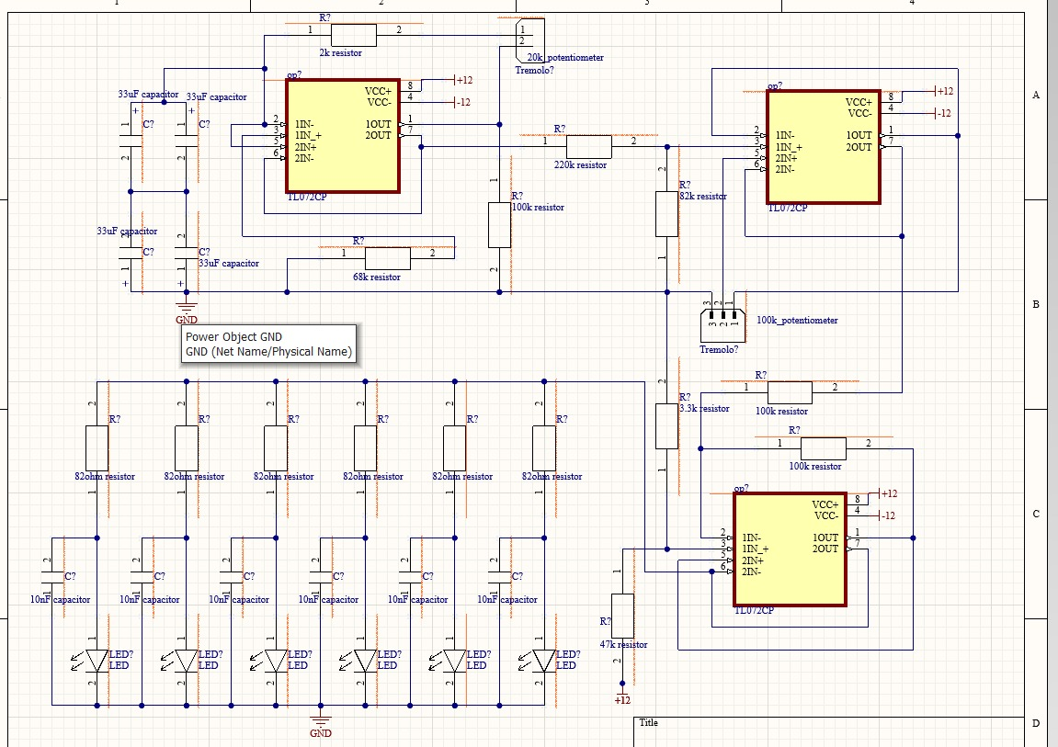
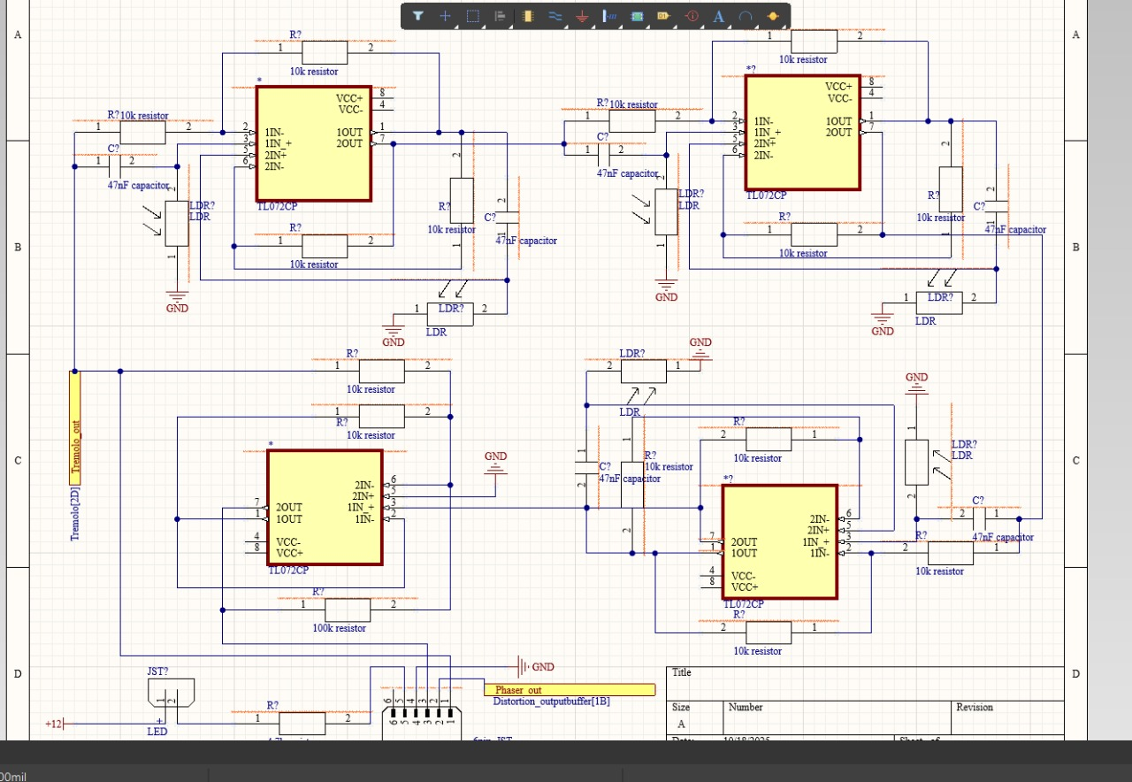
PCB Schematic (Phaser Module)

Slide 17
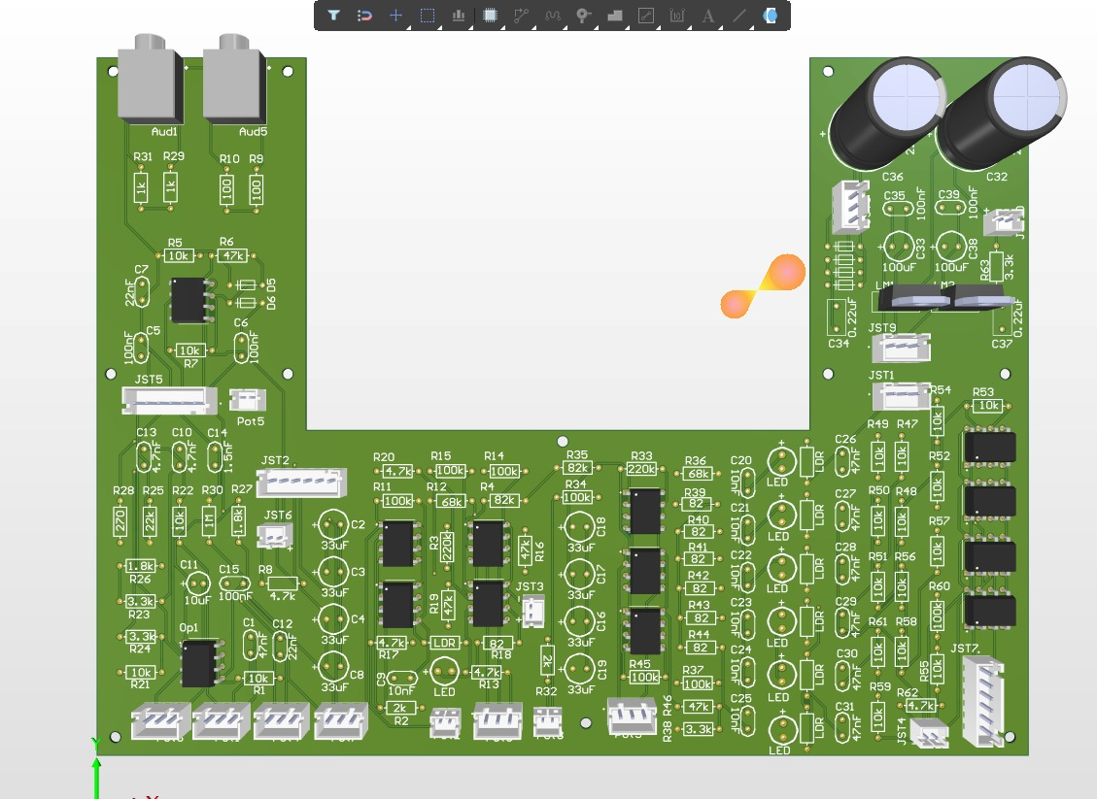
PCB Layout

Slide 18
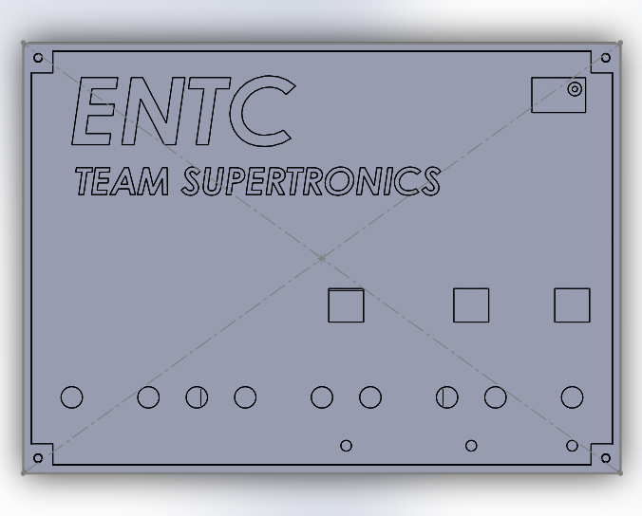
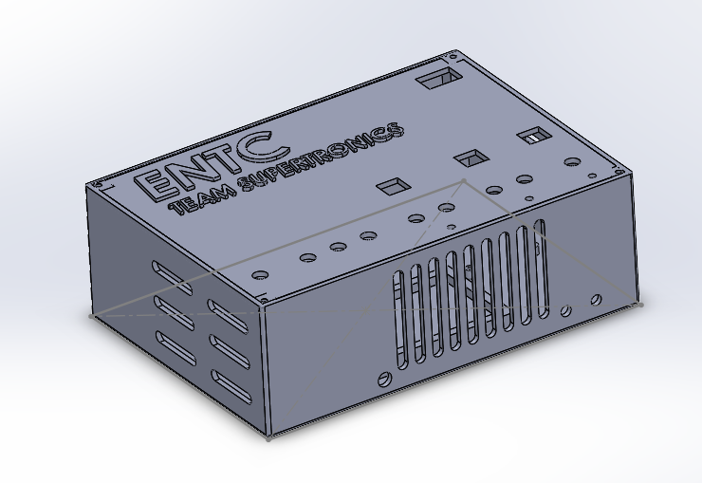
Enclosure Design

Slide 19
Task Allocation
230045X | Overdrive Module, PCB Design
230140J | Phaser Module, Enclosure Design
230477X | Tremolo Module, Component Selection, Assembling
230730T | Audio Equalizer, Power Supply

Slide 20
Thank You
Team SuperTronics

